Slide 1

jQuery
jQuery Library, Selectors, DOM Manipulation, Events, Plugins
SoftUni Team
Technical Trainers
Software University
http://softuni.bg

Slide 2
Table of Contents
jQuery Overview
jQuery Selectors
DOM Manipulation
Handling Events
jQuery Plugins

Slide 3
Have a Question?
sli.do #JS-CORE

Slide 4
What is jQuery?
Cross-browser JavaScript library
Dramatically simplifies DOM manipulation
Simplifies AJAX calls and working with RESTful services
Free, open-source software: https://jquery.com
<script src="https://code.jquery.com/jquery-3.1.1.min.js"></script>
Load jQuery from its official CDN
$('li').css('background', '#DDD');
Change the CSS for all <li> tags

Slide 5

Why jQuery?
Very popular
66,179,046 live websites use jQuery
Easy to learn
Large community
Cross-browser support
Official web site: http://jquery.com

Slide 6
Using jQuery from CDN
<script src="https://code.jquery.com/jquery-
3.1.1.min.js" integrity="sha256-
hVVnYaiADRTO2PzUGmuLJr8BLUSjGIZsDYGmIJLv2b8=
"crossorigin="anonymous"></script>
$(function() {
$("a").on('click', (event) => {
alert("Link forbidden!");
event.preventDefault();
});
});

Slide 7
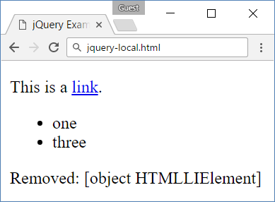
Using jQuery from Local Script
<script src="jquery-3.1.1.min.js"></script>
<p>This is a <a href="https://softuni.bg">link</a>.
</p><ul><li>one</li><li>two</li><li>three</li></ul>
$(function() {
$("body *").on('click', function(event) {
$(this).fadeOut();
$(document.body).append(
'Removed: ' + $(this).text() + '<br>');
event.preventDefault();
event.stopPropagation();
});
});

Slide 8
Selection with jQuery
jQuery selectors return a collection matched items
http://learn.jquery.com/using-jquery-core/selecting-elements/
Selected elements can be processed as a group
$('div') // document.getElementsByTagName('div');
$('.menu-item') // document.getElementsByClassName('.menu-item');
$('#navigation') // document.getElementById('navigation');
$('ul.menu li') // document.querySelectorAll('ul.menu li');
$('div').css('background', 'blue'); // Make all DIVs blue

Slide 9
jQuery Selectors
jQuery selection is the same as the querySelector in Vanilla JS
All selector
Class selector
Element selector
Id selector
Multi-selector
$('*') // Selects all elements
$('.class') // Select by class name
$('section') // Select by tag name
$('#id') // Selects a element by given id
$('selector1, selector2') // Combined

Slide 10
Filter Selectors in jQuery
$('li:even') // Even <li>
$('li:odd') // Odd <li>
$('li:first') // First <li>
$('li:last') // Last <li>
$('li:first-child') // Selects the first child of <li>
$('li:has(p)') // Selects all <li> holding <p> inside
$('li:contains("Sofia")') // Selects <li> holding given text
$('li:eq(2)') // Selects the third <li> element
$('li:not(:checked)') // Elements not matching the selector

Slide 11
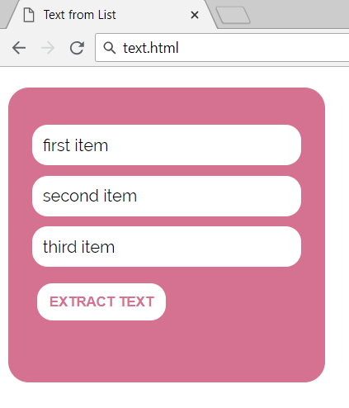
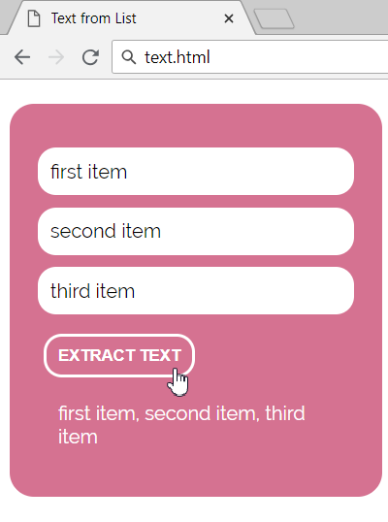
Problem: Text from List
An HTML page holds a list of text items + [Extract Text] button
Write a JS function to display all list items, separated by ","

Slide 12
Problem: Text from List – HTML
<article> <ul id="items">
<li>first item</li>
<li>second item</li>
<li>third item</li>
</ul>
<button onclick="extractText()"> Extract Text
</button>
<div id="result"></div>
</article>

Slide 13
Solution: Text from List
function extractText() {
let items = $("ul#items li")
.toArray()
.map(li => li.textContent)
.join(", ");
$("#result").text(items);
}
Check your solution here: https://judge.softuni.bg/Contests/1547

Slide 14
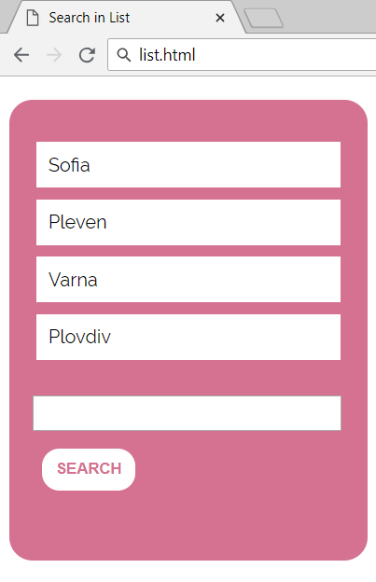
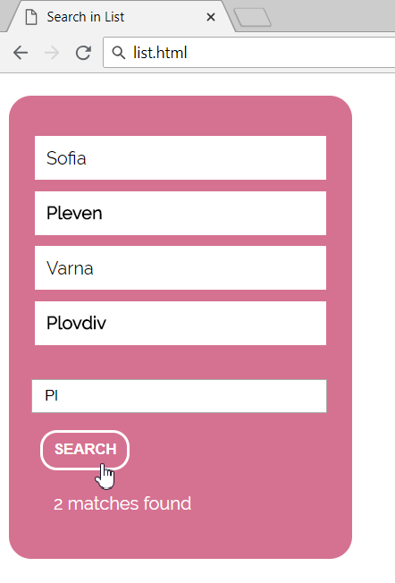
Problem: Search in List
A HTML page holds a list of towns + search box + [Search] button
Write a JS function to highlight all towns holding the search text

Slide 15
Problem: Search in List – HTML
<acticle> <ul id="towns">
<li>Sofia</li>
<li>Pleven</li>
<li>Varna</li>
<li>Plovdiv</li>
</ul>
<input type="text" id="searchText" />
<button onclick="search()">Search</button>
<div id="result"></div> </article>

Slide 16
Solution: Search in List
function search() {
let searchText = $('#searchText').val();
let matchedElements =
$(`#towns li:contains('${searchText}')`);
$("#towns li").css('font-weight', '');
matchedElements.css('font-weight', 'bold');
$("#result").text(matchedElements.length + ' maches found.');
}
Check your solution here: https://judge.softuni.bg/Contests/1547

Slide 17

Adding and Removing DOM Elements
Altering the DOM with jQuery

Slide 18
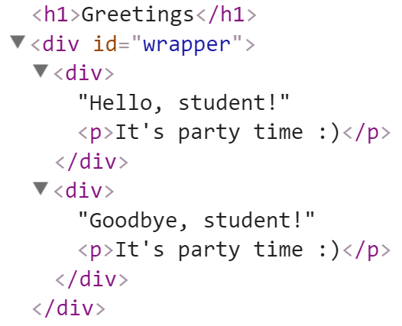
Adding Elements with jQuery
Select the parent element, then use:
append() / prepend()
appendTo() / prependTo()
<div id="wrapper">
<div>Hello, student!</div>
<div>Goodbye, student!</div>
</div>
$('#wrapper div').append("<p>It's party time :)</p>");
$('<h1>Greetings</h1>').prependTo('body');

Slide 19
Creating / Removing Elements
let div = $('<div>');
div.text('I am a new div.');
div.css('background', 'blue');
div.css('color', 'white');
$(document.body).append(div);
let paragraph = $('<p>Some text</p>');
paragraph.appendTo(div);
$('div').remove();

Slide 20
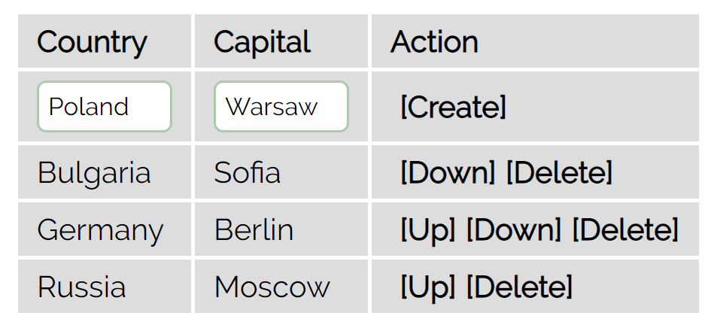
Problem: Countries Table
You are given a HTML table holding countries with their capital
Implement add / delete / move up / move down actions for the table rows
Initially add these countries:
Bulgaria / Sofia
Germany / Berlin
Russia / Moscow

Slide 21
Problem: Countries Table – HTML
<table id="countriesTable">
<tr><th>Country</th><th>Capital</th><th>Action</th></tr>
<tr><td><input type="text" id="newCountryText" /></td>
<td><input type="text" id="newCapitalText" /></td>
<td><a href="#" id="createLink">[Create]</a></td>
</tr>
</table>
<script>$(() => initializeTable())</script>

Slide 22
Solution: Countries Table – Initialize Table
function initializeTable() {
$("#createLink").on('click', createCountry);
addCountryToTable("Bulgaria", "Sofia");
addCountryToTable("Germany", "Berlin");
addCountryToTable("Russia", "Moscow");
fixRowLinks();
// Functions addCountryToTable(country, capital),
createCountry(), moveRowUp(), moveRowDown(), deleteRow(),
fixRowLinks()come here …

Slide 23
Solution: Countries Table – Create Country
function createCountry() {
let country = $('#newCountryText').val();
let capital = $('#newCapitalText').val();
addCountryToTable(country, capital, true);
$('#newCountryText').val('');
$('#newCapitalText').val('');
fixRowLinks();
}

Slide 24
Solution: Countries Table – Add Country Row
function addCountryToTable(country, capital) {
let row = $('<tr>')
.append($("<td>").text(country))
.append($("<td>").text(capital))
.append($("<td>")
.append($("<a href='#'>[Up]</a>").on('click', moveRowUp))
.append($("<a href='#'>[Down]</a>").on('click', moveRowDown))
.append($("<a href='#'>[Delete]</a>").on('click', deleteRow)));
row.css('display','none');
$("#countriesTable").append(row);
row.fadeIn();
}

Slide 25
Solution: Countries Table – Row Up
function moveRowUp() {
let row = $(this).parent().parent();
row.fadeOut(function() {
row.insertBefore(row.prev());
row.fadeIn();
fixRowLinks();
});
}

Slide 26
Solution: Countries Table – Row Down
function moveRowDown() {
let row = $(this).parent().parent();
row.fadeOut(function() {
row.insertAfter(row.next());
row.fadeIn();
fixRowLinks();
});
}

Slide 27
Solution: Countries Table – Delete Row
function deleteRow() {
let row = $(this).parent().parent();
row.fadeOut(function() {
row.remove();
fixRowLinks();
});
}

Slide 28
Solution: Countries Table – Fix Row Links
function fixRowLinks() {
// Show all links in the table
$('#countriesTable a').css('display', 'inline');
// Hide [Up] link in first table data row
let tableRows = $('#countriesTable tr');
$(tableRows[2]).find("a:contains('Up')")
.css('display', 'none');
// Hide the [Down] link in the last table row
$(tableRows[tableRows.length - 1]).find("a:contains('Down')")
.css('display', 'none'); }}

Slide 29



event
jQuery
click
Handling Events
jQuery Events

Slide 30
jQuery Events: Attach / Remove
Attaching events on certain elements
$('a.button').on('click', buttonClicked);
function buttonClicked() {
$('.selected').removeClass('selected');
$(this).addClass('selected');
// "this" is the event source (the hyperlink clicked)
}
Removing event handler from certain elements
$('a.button').off('click', buttonClicked);

Slide 31
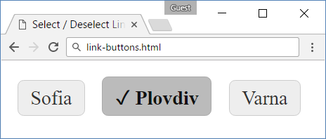
Problem: Link Buttons – HTML
link-buttons.html
<head>
<link rel="stylesheet" href="link-buttons.css" />
<script src="jquery-3.1.1.min.js"></script>
<script src="link-buttons.js"></script>
</head>
<body onload="attachEvents()">
<a class="button">Sofia</a>
<a class="button">Plovdiv</a>
<a class="button">Varna</a>
</body>

Slide 32
Problem: Link Buttons – CSS
link-buttons.css
a.button {
border: 1px solid #CCC;
background: #EEE;
padding: 5px 10px;
border-radius: 5px;
color: #333;
text-decoration: none;
display: inline-block;
margin: 5px;
}
a.button.selected {
color: #111;
font-weight: bold;
border: 1px solid #AAA;
background: #BBB;
}
a.button.selected::before {
content: "\2713\20\20";
}
a:hover {cursor: pointer;}

Slide 33
Solution: Link Buttons – JavaScript
link-buttons.js
function attachEvents() {
$('a.button').on('click', buttonClicked);
function buttonClicked() {
$('.selected').removeClass('selected');
$(this).addClass('selected');
// "this" is the event source (the hyperlink clicked)
}
}
Check your solution here: https://judge.softuni.bg/Contests/1547

Slide 34
jQuery Events: Multiple
Handling events on multiple elements
Add a handler on the parent element
function onListItemClick() {
$('.selected').removeClass('selected');
$(this).addClass('selected');
}
$('ul').on('click', 'li', onListItemClick);

Slide 35
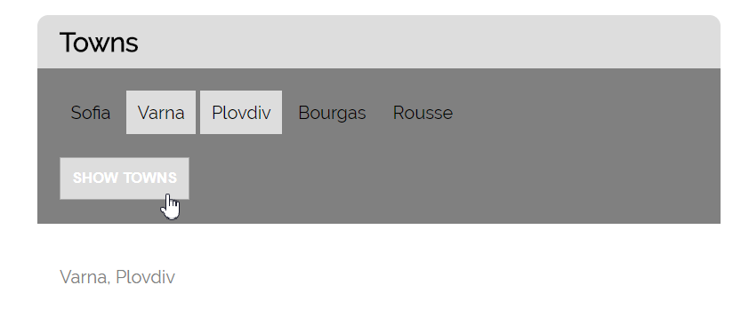
Problem: Selectable Towns
An HTML page listing towns
Clicking on a town should select / deselect it
A button shows all selected towns
<ul id="items"><li>Sofia</li><li>Varna</li>…</ul>
<button id="showTownsButton">Show Towns</button>
<div id="selectedTowns"></div>
<script>$(()=>attachEvents())</script>

Slide 36
Solution: Selectable Towns – Click Towns
function attachEvents() {
$('#items').on('click', 'li', function() {
let li = $(this);
if (li.attr('data-selected')) {
li.removeAttr('data-selected');
li.css('background', '');
} else {
li.attr('data-selected', 'true');
li.css('background', '#DDD');
}
});
Attach attribute 'data-selected' = 'true' to each selected <li>

Slide 37
Solution: Selectable Towns – Show Towns
$('#showTownsButton').on('click', function() {
let selLi = $('#items li[data-selected=true]');
let towns = selLi.toArray()
.map(li => li.textContent).join(', ');
$('#selectedTowns')
.text("Selected towns: " + towns);
});
}
Check your solution here: https://judge.softuni.bg/Contests/1547

Slide 38


$
jQuery Plugins

Slide 39
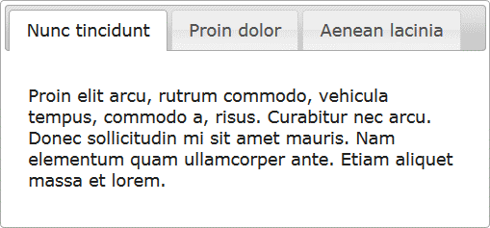
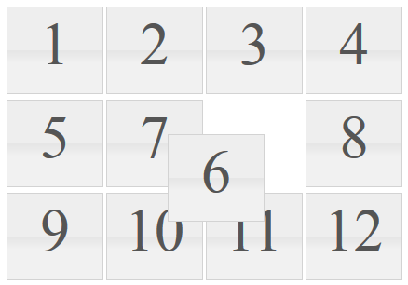
jQuery Plugins
jQuery has many ready-to-use plugins
Plugins for UI
Tabs - https://jqueryui.com/tabs/
Arrangeable elements (with drag and drop)
https://jqueryui.com/sortable/#display-grid
$('#tabs-holder').tabs();
$('#grid').sortable();

Slide 40
Creating jQuery Plugins
(function($) {
$.fn.highlight = function(className) {
$(this).on("mouseover", function() {
$(this).addClass(className);
});
$(this).on("mouseout", function() {
$(this).removeClass(className);
});
}
}(jQuery));
$(".item").highlight('big');

Slide 41
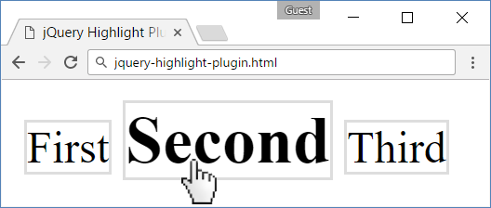
Using the Highlight jQuery Plugin
<style>
.item { border: 1px solid #DDD }
.big { font-size: 1.5em; font-weight: bold; }
</style>
<span class="item">First</span>
<span class="item">Second</span>
<span class="item">Third</span>
<script>$(".item").highlight('big');
</script>

Slide 42

Live Exercises in Class (Lab)
Practice: Using jQuery

Slide 43

Summary
…
…
…
jQuery is very powerful on DOM manipulation
Very popular library, run over 66 179 046 sites
Select + edit DOM elements:
Create elements:
Handle events:
$('p.red').css('background', 'blue');
$('<h1>Hello</h1>').appendTo('body');
$('#items').click(function() { … });

Slide 44
https://softuni.bg/courses/javascript-advanced

Slide 45













SoftUni Diamond Partners

Slide 46




SoftUni Organizational Partners

Slide 47




Trainings @ Software University (SoftUni)
Software University – High-Quality Education and Employment Opportunities
softuni.bg
Software University Foundation
http://softuni.foundation/
Software University @ Facebook
facebook.com/SoftwareUniversity
Software University Forums
forum.softuni.bg

Slide 48

License
This course (slides, examples, demos, videos, homework, etc.) is licensed under the "Creative Commons Attribution-NonCommercial-ShareAlike 4.0 International" license

